Slide 1
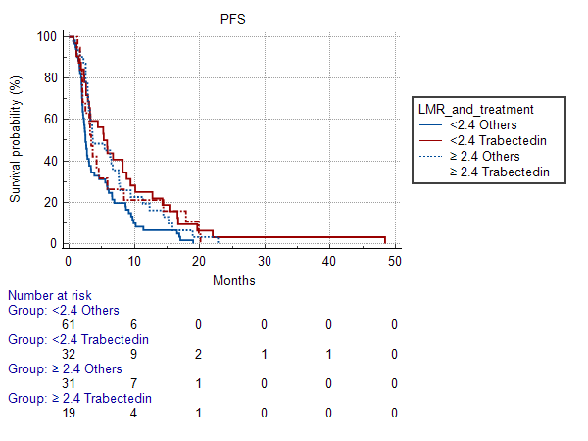
Notes:
Figure 1. Progression free survival according to LMR and treatment (Trabectedin VS Others)

