Slide 1
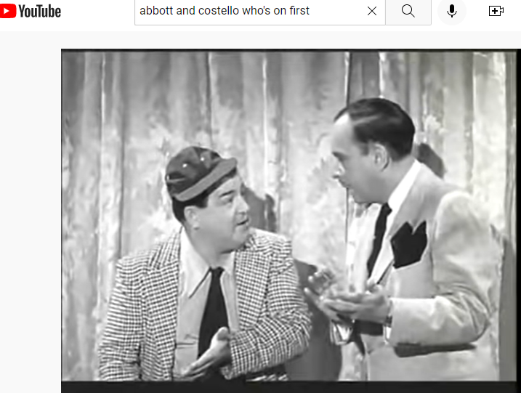
Virtual Visits Information and Education
can help “Whose on First” (the Patient)
https://www.youtube.com/watch?v=kTcRRaXV-fg&t=260s

