Slide 1
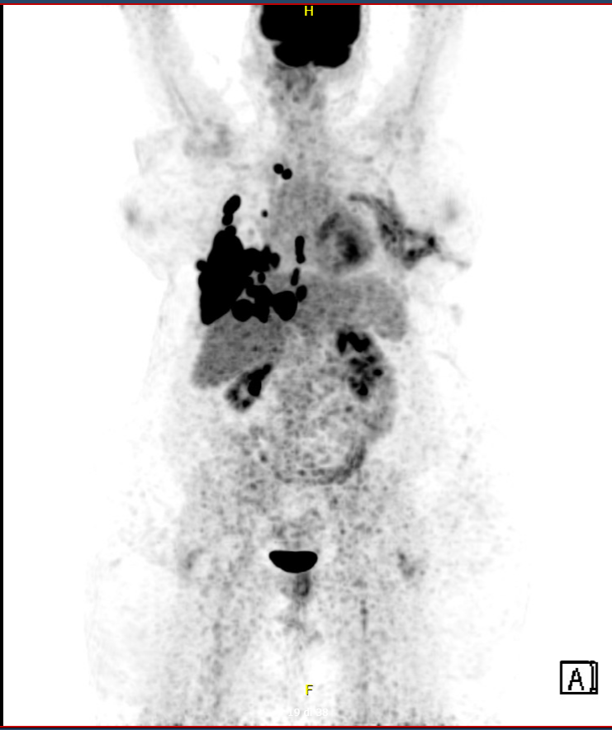
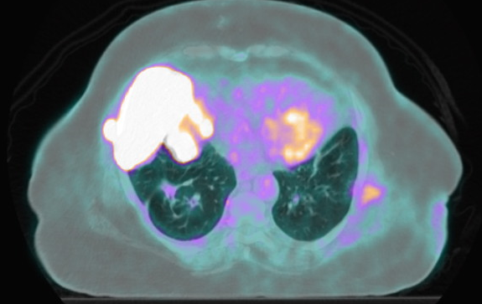
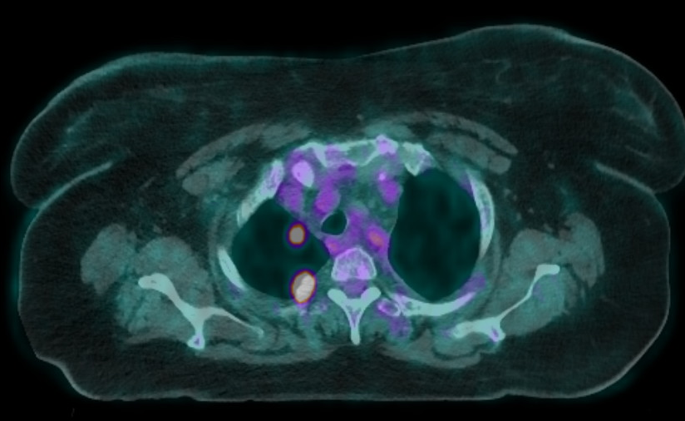
Undifferentiated pleomorphic sarcoma S133K
2 hpi
72 hpi
CTR
IFO+EPI
GEM+DOCE

